Slide 1
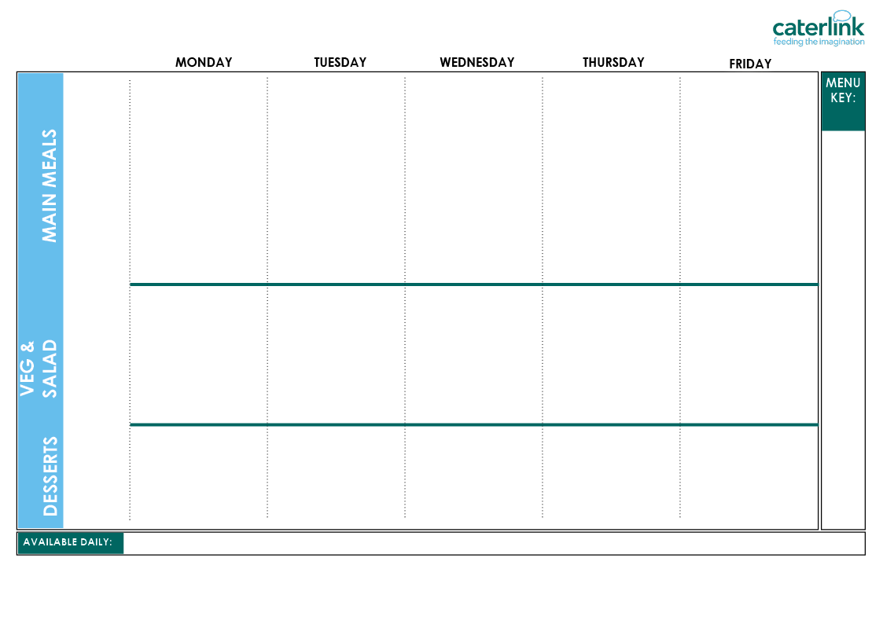








WEEK 1 ISLINGTON SPRING SUMMER MENU 2026
Planet Friendly Day
Option One
Option Two
Option Three
Vegetables
Salad Bar
Dessert
v
Quorn burger Patty Wedges & Tomato Sauce (VE) | Macaroni Cheese with Roasted Vegetable and Olive Bread (V) | Roasted Quorn, Roast Potatoes & Gravy (VE) | Chickpea Curry with Rice (VE) | NEW Cheesy Broccoli Frittata with Chips (V)
Mild Mexican Chilli with Rice and Sweetcorn Bread (VE) | Chicken 50% Enchilada Bake with Paprika Wedges | Roast Chicken, Stuffing, Roast Potatoes & Gravy | Hearty Beef and Lentil Bolognaise with Spaghetti | Fishfingers or Salmon Fishfingers with Chips & Tomato Sauce
Jacket Potato with Baked Beans (VE) | Jacket Potato (VE) with Tuna (V) | Jacket Potato (VE) with Cheese (V) | Jacket Potato with Salmon Mayonnaise | Jacket Potato with Baked Beans (VE)
Roasted Tomatoes (VE) Butternut Squash (VE) | Green Beans (VE) Carrots (VE) | Red Cabbage (VE) Broccoli (VE) | Carrots (VE) Cauliflower (VE) | Peas (VE) Sweetcorn (VE)
Roasted Vegetable and Lentil Salad (VE) Carrot Sticks (VE) Mixed Lettuce (VE) Diced Peppers (VE) Sweetcorn (VE) | Sweet Potato and Coriander Salad (VE) Tomatoes (VE) Lettuce (VE) Cucumber (VE) Coleslaw (V) | Rainbow Slaw (VE) Green Bean Salad (VE) Cucumber (VE) Tabbouleh Salad (VE) Carrot Sticks (VE) | Beetroot and Orange Salad (VE) Tomato Pasta (VE) Sweetcorn (VE) Lettuce (VE) Tomatoes (VE) | Lettuce (VE) Pepper Sticks (VE) BBQ Noodle Salad (V) Grated Carrot (VE) Beetroot (VE)
Yoghurt (V) with Sunflower Seeds and Fresh Fruit (VE) | Orange Drizzle Cake (V) | Yoghurt (V) with Sunflower Seeds and Fresh Fruit (VE) | Apple Flapjack (VE) | Strawberry Jelly with Mandarins (VE)
Whole
grain
Plant
based
Added plant protein
Chef’s Special
Local
Red Tractor
Meat
Local, Seasonal Fruit & Veg
Contains Flaxseed (high in Omega-3)
Freshly cooked jacket potatoes with a choice of fillings (V/VE) - A choice of flavoured breads freshly baked on site daily (VE) - Daily salad selection (V/VE) – Fresh Fruit (VE) – Natural Yoghurt (V/VE) - Drinking Milk (V/VE)
(V) Vegetarian (VE) Vegan
If you would like to know about particular allergens in foods, please ask a member of the catering team for information. If your child has a school lunch and has a food allergy or intolerance you will be asked to complete a form to ensure we have the necessary information to cater for your child. We use a large variety of ingredients in the preparation of our meals and due to the nature of our kitchens it is not possible to completely remove the risk of allergen cross contact.

Slide 2
WEEK 2 ISLINGTON SPRING SUMMER MENU 2026
Planet Friendly Day
Option One
Option Two
Option Three
Vegetables
Salad Bar
Dessert
Spaghetti & Planet Friendly Balls with Tomato and Herb Bread (VE) | Classic Cheese & Tomato Pizza with Summer Mixed Salad (V) | Lentil Wellington, Roast Potatoes & Gravy (VE) | Lentil and Basil Whirl with Herby Rice, Tzatziki & Salad (V) | Saucy Tomato Pasta (VE)
Summer Butterbean Vegetable Risotto (VE) | Beef Chilli with Rice & Sweetcorn & Cucumber Salsa | Chicken Sausage, Roast Potatoes & Gravy | Greek Chicken Pitta with Herby Rice, Tzatziki & Salad | Battered Fish with Chips & Tomato Sauce
Jacket Potato (VE) with Five Bean Chilli (VE) | Jacket Potato with Cheese (V) | Jacket Potato with Tuna and Sweetcorn Mayonnaise | Loaded Jackets (V) | Jacket Potato with Baked Beans (VE)
Carrots (VE) Spring Greens (VE) | Sweetcorn (VE) Broccoli (VE) | Roast Vegetables(VE) Peas (VE) | Green Beans (VE) Cauliflower (VE) | Peas (VE) Coleslaw(VE)
Mixed Bean Salad (VE) Lettuce (VE) Tomato Pasta (VE) Cucumber Slices (VE) Beetroot (VE) | Grated Carrot (VE) Cucumber Sticks (VE) Roasted Vegetable and Lentil Salad (VE) Tomato Salsa (VE) Beetroot (VE) | Grated Carrot and Raisin Salad (VE) Coleslaw (V) Green Bean Salad (VE) Diced Pepper (VE) Cucumber (VE) | Carrot Sticks (VE) Rainbow Slaw (VE) Iceberg Lettuce (VE) Tomatoes (VE) Couscous Salad (VE) | Sweet Potato Power Salad (VE) Mixed Lettuce (VE) Carrot Sticks (VE) Pepper Sticks (VE) Sweetcorn (VE)
Yoghurt (V) with Granola and Fresh Fruit (VE) | Peaches (VE) & Ice Cream (V) | Yoghurt (V) with Sunflower Seeds and Fresh Fruit (VE) | Chocolate and Banana Oaty Square (VE) | Carrot Cake (V)
Whole
grain
Plant
based
Added plant protein
Chef’s Special
Local
Red Tractor
Meat
Local, Seasonal Fruit & Veg
Contains Flaxseed (high in Omega-3)
Freshly cooked jacket potatoes with a choice of fillings (V/VE) - A choice of flavoured breads freshly baked on site daily (VE) - Daily salad selection (V/VE) – Fresh Fruit (VE) – Natural Yoghurt (V/VE) - Drinking Milk (V/VE)
(V) Vegetarian (VE) Vegan
If you would like to know about particular allergens in foods, please ask a member of the catering team for information. If your child has a school lunch and has a food allergy or intolerance you will be asked to complete a form to ensure we have the necessary information to cater for your child. We use a large variety of ingredients in the preparation of our meals and due to the nature of our kitchens it is not possible to completely remove the risk of allergen cross contact.

Slide 3
WEEK 3 ISLINGTON SPRING SUMMER MENU 2026
Planet Friendly Day
Wholemeal Vegetable Pasta Bake (VE) | Vegetable Loaf with Stuffing, Mashed Potatoes & Gravy (VE) | Chickpea and Vegetable Biryani and Turmeric Bread (VE) | Cowboy Sausage and Bean Hot Pot (VE) | Cheese & Bean Pasty with Chips & Tomato Sauce (V)
Chinese Vegetable Noodles (V) | Beef Lasagne with Garlic Bread | Peri Peri Chicken with Roast Potatoes and Rainbow Slaw | Chef Shilpa’s Chicken Korma with Rice | Fishfingers with Chips & Tomato Sauce
Jacket Potato with Five Bean Chilli (VE) | Jacket Potato with Baked Beans (VE) | Jacket Potato Cheese (V) | Jacket Potato with Tuna and Sweetcorn Mayonnaise | Jacket Potato with Baked Beans (VE)
Carrots (VE) Peppers (VE) | Vegetable Medley (VE) Broccoli (VE) | Sweetcorn (VE) Peas (VE) | Green Beans (VE) Red Cabbage (VE) | Baked Beans (VE) Peas (VE)
Rainbow Slaw (VE) Beetroot (VE) Butternut Squash (VE) Mixed Lettuce (VE) Cucumber Sticks (VE) | Mixed Bean Salad (VE) Beetroot (VE) Iceberg Lettuce (VE) Tomatoes (VE) Couscous Salad (VE) | Tomatoes (VE) Cucumber Slices(VE) Grated Carrot (VE) Green Bean Salad(VE) Vegetable Pasta Salad (VE) | Sweet Potato Salad (VE) Carrot Sticks (VE) Diced Pepper (VE) Sweetcorn Salsa (VE) Tomatoes (VE) | Apple and Raisin Salad (V) Coleslaw (V) Grated Carrot (VE) Mixed Lettuce (VE) Pepper Sticks (VE)
Yoghurt (V) with Sunflower Seeds and Fresh Fruit (VE) | Chocolate Orange Cookie (VE) | Yoghurt (V) and Fresh Fruit (VE) | Strawberry and Apple Crumble (VE) with Custard (V) | Pineapple Upside Down Cake (V)
Option One
Option Two
Option Three
Vegetables
Salad Bar
Dessert
Whole
grain
Plant
based
Added plant protein
Chef’s Special
Local
Red Tractor
Meat
Local, Seasonal Fruit & Veg
Contains Flaxseed (high in Omega-3)
Freshly cooked jacket potatoes with a choice of fillings (V/VE) - A choice of flavoured breads freshly baked on site daily (VE) - Daily salad selection (V/VE) – Fresh Fruit (VE) – Natural Yoghurt (V/VE) - Drinking Milk (V/VE)
(V) Vegetarian (VE) Vegan
If you would like to know about particular allergens in foods, please ask a member of the catering team for information. If your child has a school lunch and has a food allergy or intolerance you will be asked to complete a form to ensure we have the necessary information to cater for your child. We use a large variety of ingredients in the preparation of our meals and due to the nature of our kitchens it is not possible to completely remove the risk of allergen cross contact.

